Slide 1
Aven Solutions (Logistics Management Solution)
Presented By
Anshuman Sinha (A45304823043)
Ayush Shivam (A45304823048)
Under the Supervision of
Mr. Amar Kumar
Assistant Professor
Amity Institute Of Information Technology, Patna May 7th, 2026

Slide 2
Outline
Introduction
Problem Statement
Objectives
Methodology
Dataset Description
System Architecture
7. Results and Discussion
8. Advantages Limitations
9. Future Scope
10. Conclusion
11. References

Slide 3

1. Introduction
Aven Solutions is a modern logistics management web application developed to simplify logistics operations through centralized management and role-based dashboards.
The system connects users, admins, and owners on a single platform to manage logistics activities efficiently.
Key Features
Real-time logistics monitoring
Bid management system
Supply tracking and Role-based dashboards
Information request management
Activity monitoring system

Slide 4
2. Problem Statement
Inefficient Logistics Tracking - Traditional logistics systems lack real-time tracking and centralized management.
Manual Bid Management - Bidding and supply operations are often handled manually, causing delays and errors.
Role Management Issues - Different stakeholders require different levels of access and monitoring capabilities.
Solution Required - A centralized web-based logistics management platform that streamlines logistics tracking, bidding, supply management, and role-based operations.

Slide 5

3. Objectives
To digitize logistics management processes
To provide centralized logistics tracking
To manage bidding activities efficiently
To improve communication between users and management
To implement secure role-based access control

Slide 6
4. Methodology
Step 1 – Requirement Analysis
Understanding logistics and bidding workflow
Step 2 – UI/UX Design
Designing dashboards for users, admins, and owners
Step 3 – Backend Development
Creating APIs and data management systems
Step 4 – Database Integration
Connecting logistics and bidding data
Step 5 – Testing
Testing modules and role-based functionality

Slide 7
5. Dataset Description
Dataset Name | Description
User Dataset | Stores user ID, login credentials, roles, and request information.
Logistics Dataset | Contains vehicle details, delivery status, source, and destination data.
Bid Dataset | Maintains bid amount, bid status, and bidding activity records.
Supply Dataset | Stores supply items, quantity details, and inventory status.
Authentication Dataset | Handles demo ID, password, and role-based login management.

Slide 8
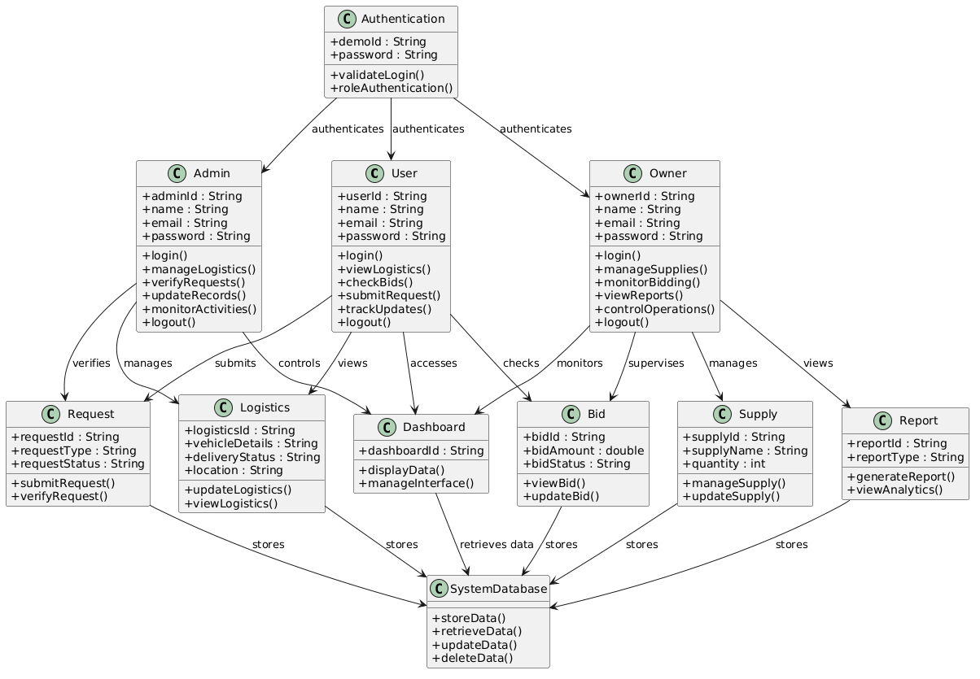
6. System Architecture (Class Diagram)

Slide 9
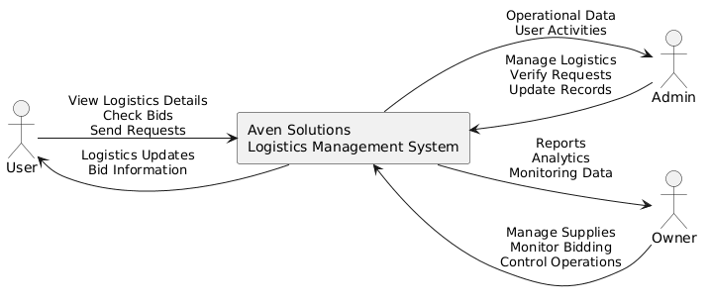
System Architecture
Level 0 DFD (Context Diagram)

Slide 10
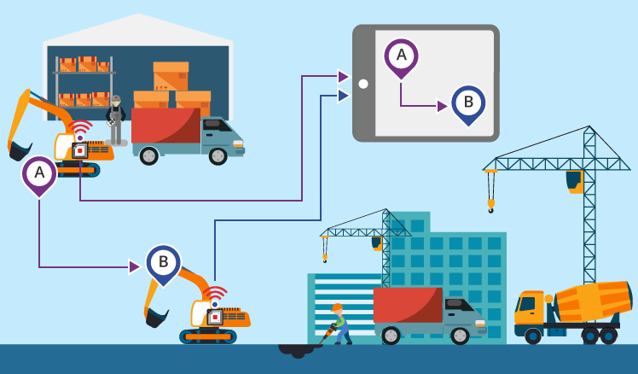
7. Results and Description
Result: Aven Solutions successfully improved logistics monitoring, bid management, operational transparency, and workflow coordination through centralized dashboards with secure role-based accessibility and real-time operational synchronization.
Description: The system provides integrated User, Admin, and Owner dashboards using modern web technologies to simplify logistics operations, supply management, bidding processes, and communication efficiency.

Slide 11
8. Advantages and Limitations
Advantages
Centralized logistics and bid management system.
Role-based secure dashboard accessibility.
Improved communication between users and management.
Real-time logistics and operational updates.
Responsive and user-friendly web interface.
Limitations
Limited cloud-based database integration.
Uses demo-based authentication instead of advanced security systems.

Slide 12
9. Future Scope
Future development can include advanced analytics dashboards, automated reporting systems, and real-time operational monitoring features to improve workflow efficiency and logistics management processes.
The system can be enhanced with cloud database integration, mobile applications, and advanced authentication technologies for better scalability, accessibility, security, and enterprise-level logistics management.

Slide 13
10. Conclusion
Aven Solutions successfully provides a centralized logistics management platform for users, admins, and owners.
The system improves logistics tracking, bid management, and operational coordination through role-based dashboards.
Real-time updates and centralized monitoring enhance communication and workflow efficiency within the organization.
The application reduces manual operational work and improves transparency in logistics management activities.

Slide 14
11. References
X. Li, Y. Ren, and X. Tao, “Task-role based access control model in logistics management system,” in Proceedings of the International Conference on Logistics Engineering and Intelligent Transportation Systems, 2010, pp. 1–5. [Online]. Available: https://pmc.ncbi.nlm.nih.gov/articles/PMC9261175/
Binary Semantics, “Quit Manual Processes & Achieve Higher Efficiency with Logistics Process Automation,” Binary Semantics Blog, Jul. 20, 2022. [Online]. Available: https://www.binarysemantics.com/blogs/quit-manual-processes-achieve-higher-efficiency-with-logistics-process-automation/
X. Li, Y. Ren, and X. Tao, “Task-role based access control model in logistics management system,” in Proceedings of the International Conference on Logistics Engineering and Intelligent Transportation Systems, Jul. 2010, pp. 1–5. [Online]. Available: https://www.researchgate.net/publication/261203176_Task-role_based_access_control_model_in_logistics_management_system

